Slide 1
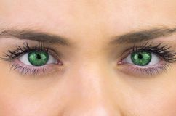
Eye Color Recognition
Octavio Sales Calvo
Emilio Miralles Rivera

Slide 2
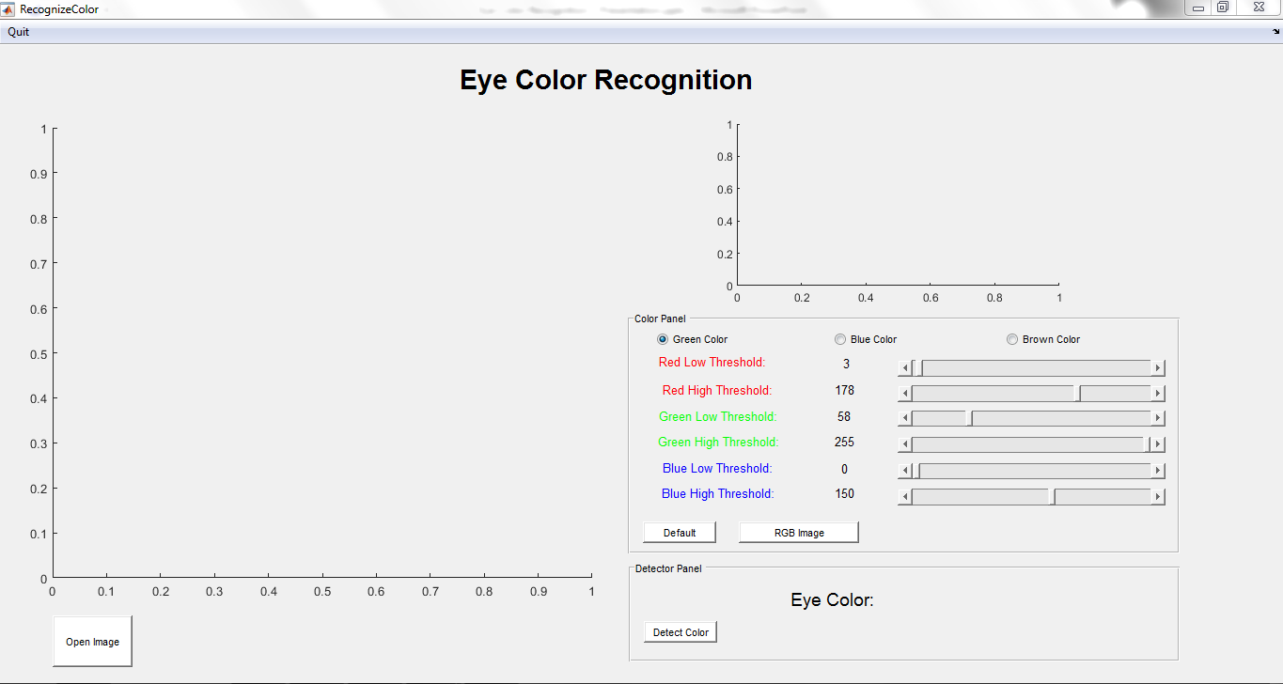
Graphical User Interface

Slide 3
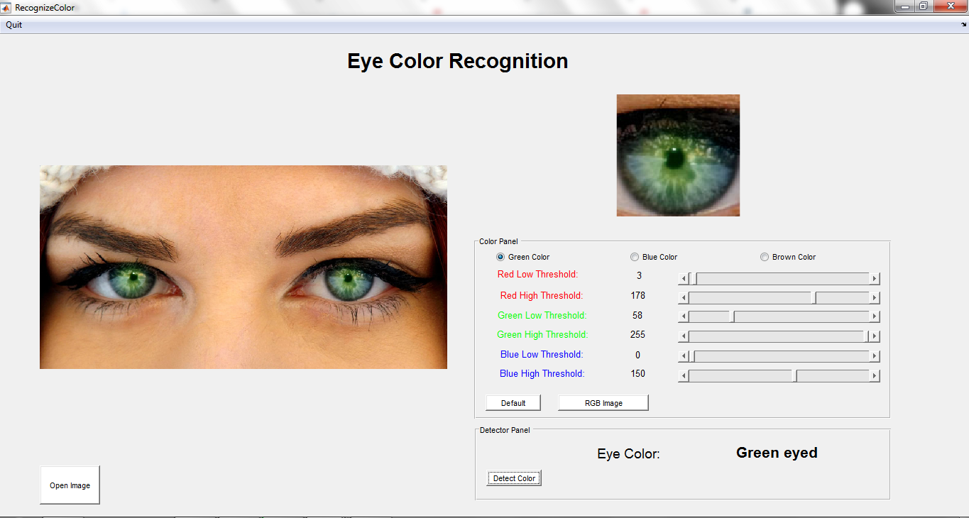
How to use it

Slide 4
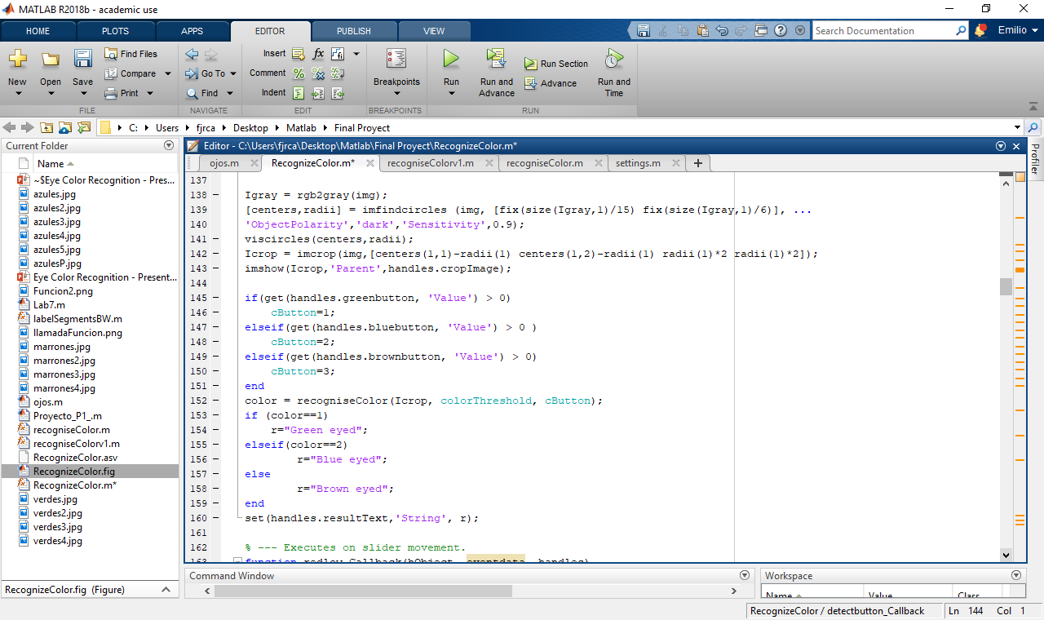
Application implementation
Imfindcircles()
Hough Circle Transform
Properties:
ObjectPolarity
Sensitivity
Radius range

Slide 5
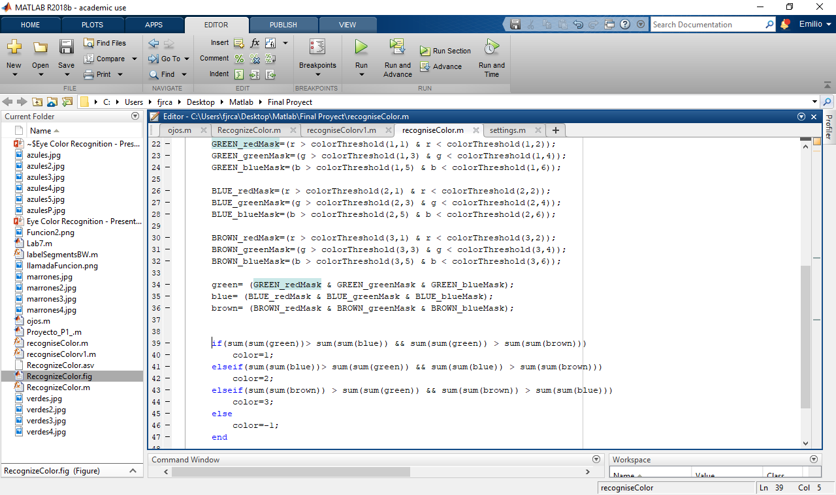
Function used: recognizeColor()
Input Arguments: cropped Image, colorThreshold and cButton.
Output Argument: eyes color detected.
Compare given thersholds to color of eye image.

Slide 6
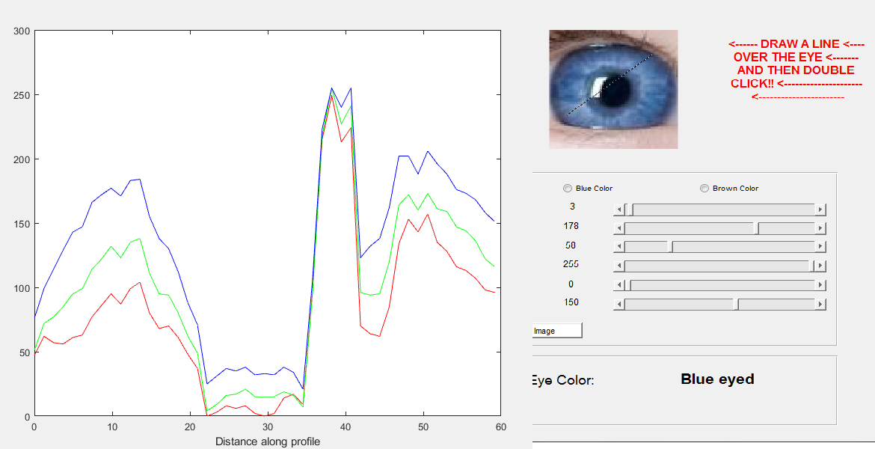
RGB Intensity Profile

Slide 7
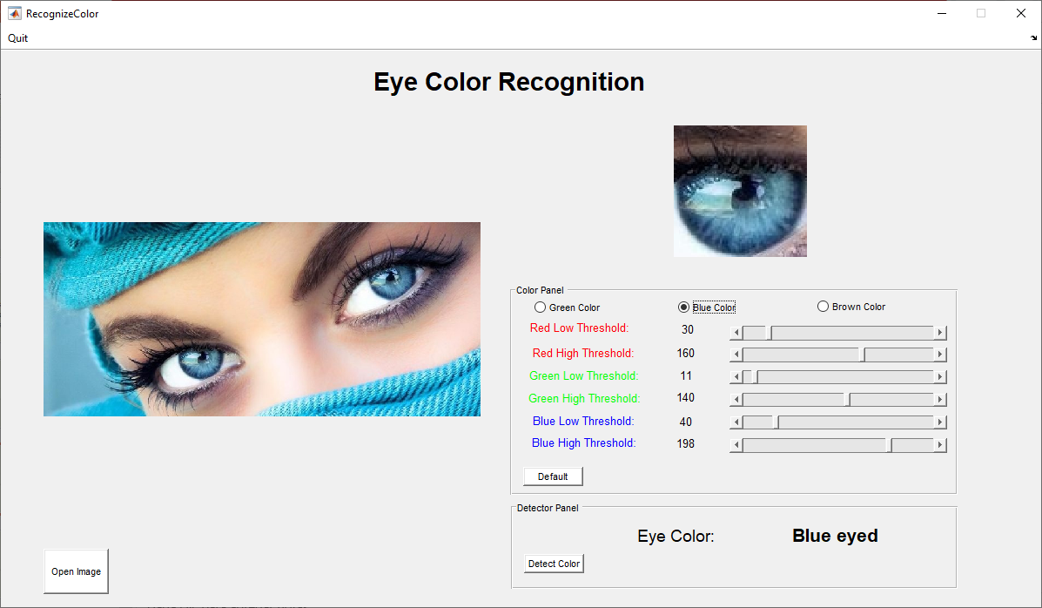
Detection possibilities

Slide 8
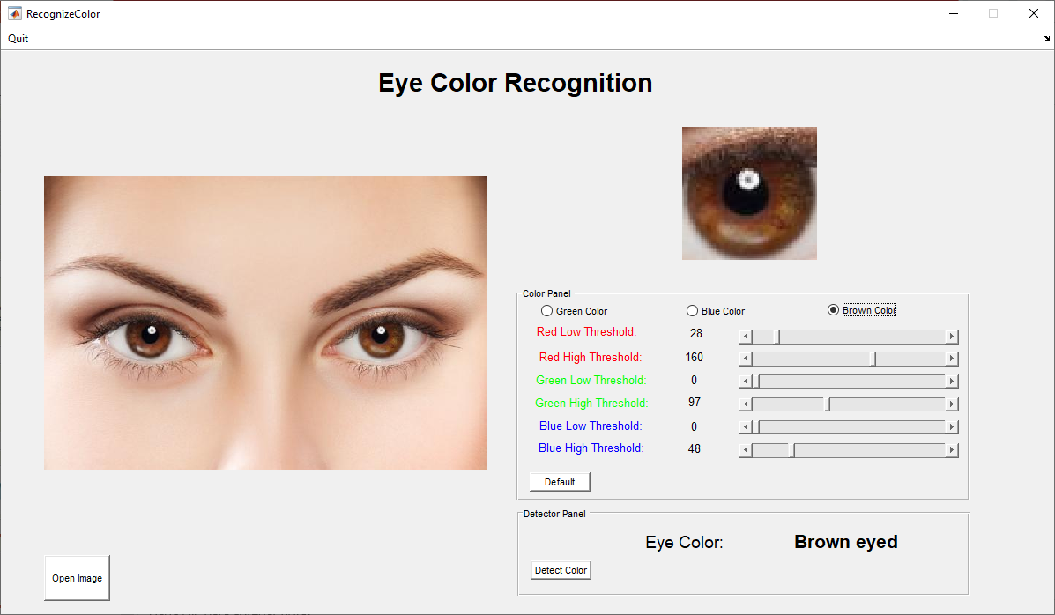
Detection Possibilities

Slide 9
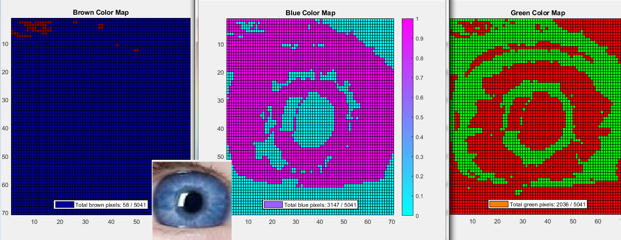
Color Maps [Brown, Blue, Green]

